Slide 1

Secondary Transfer
April 2026

Slide 2
The aims of today’s meeting are:
To explain the process of Secondary Transfer
To provide you with information on how you can best support your child through the process.
To provide you with approximate dates

Slide 3
There are 33 Local Education Authorities (LEAS) in London. LEAS are responsible for running central services, such as school transport and facilities for children with special needs, as well as administering admissions for those schools that come directly under their control.
Guidelines are produced annually by each LEA which give the admissions policy and details of each school for that year.

Slide 4
You do not have to choose a school in the borough in which you live. The right to apply to any school you choose is not the same as a right to a place.
Legally only your own borough has a duty to find a school place for your child. Otherwise, it is up to you to find a school and persuade the relevant admissions authority that your child meets the admission criteria. These criteria must, the law states, be clear, objective, and published openly (Look on school or Borough websites)

Slide 5
Since 2005, a London – wide admissions system has been implemented. To apply to most state secondary schools, you need complete only the ‘Secondary Common Application Form’ (SCAF), even if you are applying for schools across borough boundaries or in nearby authorities (Bexley or Kent, for example).

Slide 6
What can you do NOW!
Visit schools
Familiarise yourself with the school, it’s facilities and find out about open days.
Speak to students about their experiences – what they like about the school
Ask the headteacher / tour leader questions.
Find out if you will have to sit a banding test for the school – be as prepared as you can be!

Slide 7
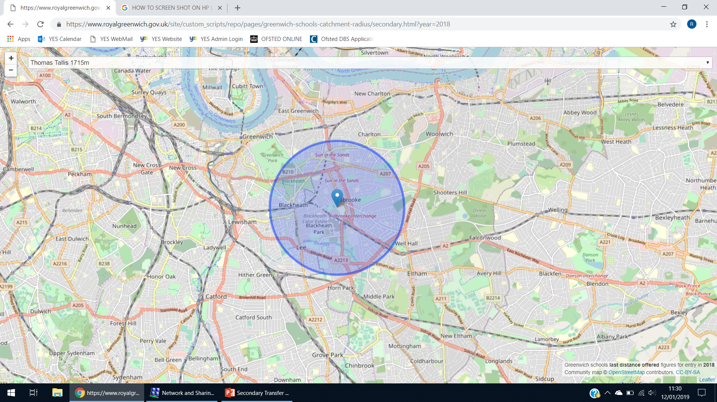
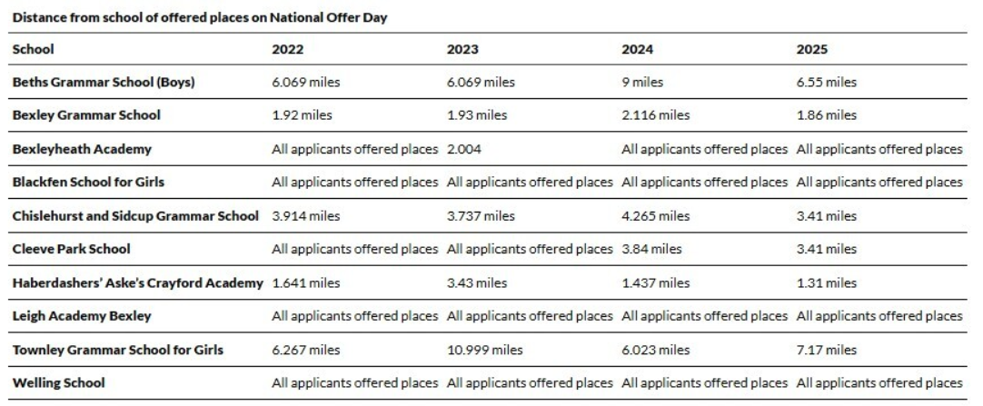
2) Use school websites / Borough information to find out about the admissions criteria
All schools will have some specific admissions criteria. This is usually in relation to where you live.
Greenwich Bexley
BEXLEY
Secondary school admissions booklets (pagesuite-professional.co.uk)

Slide 8
Some state schools, typically selective and voluntary – aided schools, also have their own admissions criteria. This could be based on gender, religious denomination or academic ability (grammar schools).
Use visits and school websites to find out realistically what the admission criteria are and your chances of being offered a place at a particular school.
For example, On the Bexley website you can download information about the Bexley Selection tests.

Slide 9
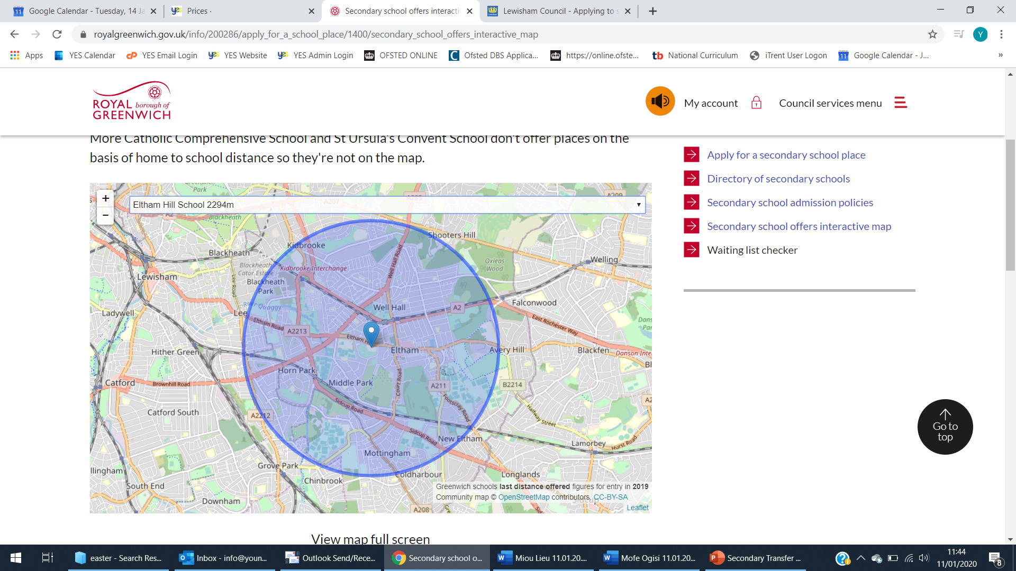
To apply for a state-run secondary school in a London Borough e.g., Greenwich and Lewisham. What you can do now:
Admissions guides – a list of all schools in the borough and clearly laid out admissions criteria (distance, religious beliefs, gender)
Secondary school admissions booklets (pagesuite-professional.co.uk)
Interactive maps – show the last distance given so you can be realistic about your choices.
Secondary school offers interactive map | Royal Borough of Greenwich (royalgreenwich.gov.uk)

Slide 10
Some state run secondary schools (usually academy chains) require pupils to sit a ‘Fair banding test’
This is to ensure that children across the full ability range are admitted.
It is not possible to pass or fail the test, but those not sitting the test at all, will only be prioritised after those children who have sat the test.
The applicants will be split into 5 equally sized bands based on their assessment results. Within each band, our admission criteria will be applied as set out in our determined admission arrangements.
Last year, the fair banding test usually comprises of Nonverbal reasoning questions.
Leigh Academy Blackheath is an example of a school which uses a fair banding test. To find out which other schools this applies to, please look in the Secondary school admissions guide for your borough.

Slide 11
To apply for a secondary school place at a Grammar school in:
Bexley: Beths, Townley Grammar, Chislehurst and Sidcup and Bexley Grammar.
Kent: Dartford boys and Girls, Wilmington Grammars
Bromley: St Olave’s, Newstead Woods
Your child will need to sit the Selection tests (11 plus) . Each borough has their own exam. You need to apply separately for each exam via the borough website. Applications usually open in May.
The 11 plus exam comprises of Maths and English, Verbal and NonVerbal reasoning.
It is a parent's responsibility to register their own child.
Some boroughs offer an ‘alert’ via their website to act as a reminder.

Slide 12
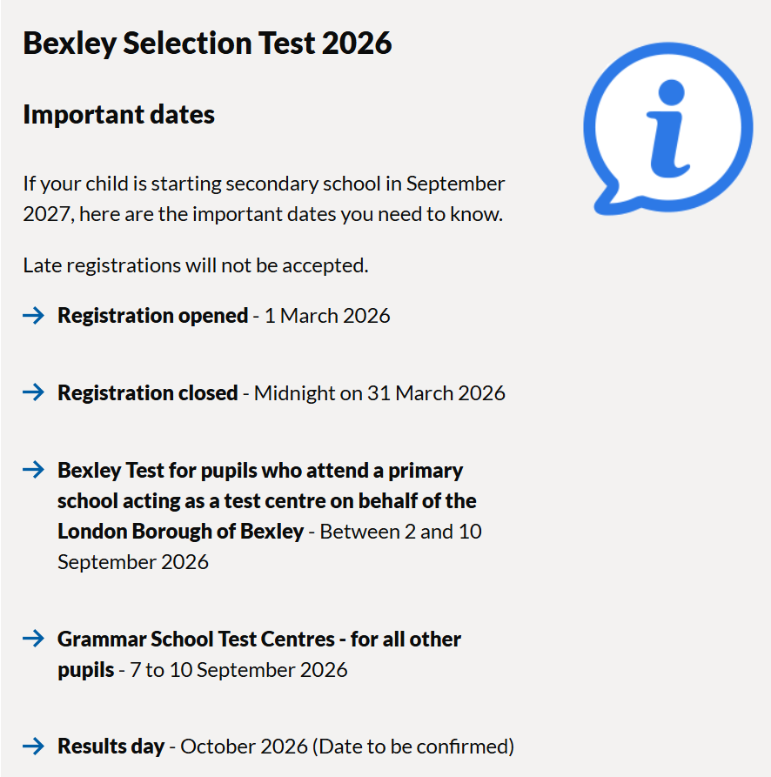
There are 800 places available at Bexley Grammar schools each year, so being deemed selective in the test, does not guarantee that your child will be offered a place (in 2022 6088 children sat the test and, 2035 pupils were deemed Selective).
If your child is deemed selective in the test, then the borough will look at the next selection criteria, which is usually siblings then distance lived from the school.

Slide 13





Slide 14
3) Ensure that pupils get the most out of their lessons with us
Please oversee Homework –please write a comment to open a dialogue with the tutor if you feel any one part of the pack was a struggle.
If there are corrections or suggestions to be made in returned homework, please work through these with your child.
Encourage your child to keep a notebook of any new/unusual words or word patterns. VOCABULARY is Key!

Slide 15
In our sessions we…
Work through the Yr 5 curriculum in Maths and English to consolidate the work which they have covered in school
Teach the different aspects of Verbal and Non-Verbal reasoning using Galore Park textbooks. This is completed in the lesson with the teacher.
Work through practise papers with each child (Summer term) in order to improve test taking skills such as timing, using multiple choice answer grids.
Holiday revision courses – longer sessions allow for in depth coverage and lots of test practice
Please read emails from us! We often get up-to-date information regarding dates of examinations early and will pass these on to you via email and using our website.

Slide 16
Mock exams – essential preparation if you plan to enter your child for the 11 plus exam.
To book: www.yestests.com
We run a summer booster during the summer break (dates and booking can be found at www.yestests.com) for children who have just finished Year 5
Our mock exams are appropriate for both Kent and Bexley exams.
From September –December, we run exams for Independent schools.

Slide 17

Keep in touch!
Please ensure we have your up-to-date phone number and email address
Website: www.yestests.com
Email: info:yestests.com
Instagram : @yestestsandtuition

